Slide 1
CS 295A/395D: Artificial Intelligence
Partial Observability II & Bayes Nets as Causal Graphs
Prof. Emma Tosch
21 March 2022

Slide 2
Agenda
New student hours: daily 10:30-noon, starting next week
Added class to my Teams calendar
May sometimes need to cut short
Starting blogging again
Recap: Bayes Nets for representing uncertain events
New: Using Bayes Nets via querying
New: Partial observability
New: Learning Bayes Nets from data

Slide 3
Recall: Factorization
Any joint probability distribution can be factorized using basic rules of probability:
P(B, E, A, F, L) = P(F | L, A, E, B) x
P(L | A, E, B) x
P(A | E, B) x
P(E | B) x
P(B)
B
E
A
F
L

Slide 4
Recall: Factorization
We can draw any factorization as a DAG where each node corresponds to a conditional probability distribution.
For discrete variables, this is a table:
B
E
A
L | B | E | A
l₁, p₁ | b₁ | e₁ | a₁
l₂, p2 | b₁ | e₁ | a₁
… | … | … | …
l_{n}, 1 – (p₁, … p_{n-1}) | b₁ | e₁ | a₁
l₁, p₁ | b₁ | e₁ | a₂
… | … | … | ..
F
L
Not strictly needed

Slide 5
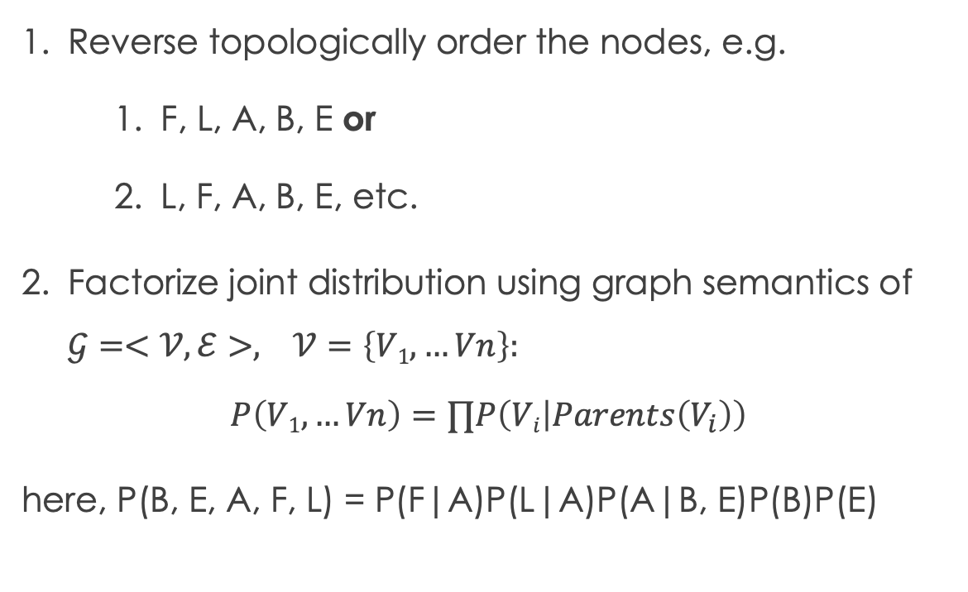
Recap: Bayes Nets as factorization
Reverse topologically order the nodes, e.g.
F, L, A, B, E or
L, F, A, B, E, etc.
Factorize joint distribution using graph semantics of $𝒢=<𝒱,ℰ>, 𝒱=\left\{V1,…Vn\right\}:$
$$P\left(V1,…Vn\right)=∏P\left(Vi | Parents\left(V_{i}\right)\right)$$
here, P(B, E, A, F, L) = P(F|A)P(L|A)P(A|B, E)P(B)P(E)
B
E
A
F
L

Slide 6
Quasi-Recap: Learning Bayes Nets (In practice)
Naïve approach: sample over a representative period, compute empirical probabilities of each possible event
Problem: some joint events are very low probability
More practical approach: encode background knowledge in a DAG
Use existing estimates for model parameters (here, probabilities of discrete events)
Targeted sampling, other population distributions as beliefs
Directly encode probabilities as beliefs
May want to encode multiple hypotheses for parameter values (more an ML topic)

Slide 7
Without Bayes Nets: arbitrary queries are inefficient
Example arbitrary queries on P(X, Y, Z, W). How to compute:
P(W) ?
P(X, Y, Z | W)?
P(X, Y | Z, W)?

Slide 8
Recap: Bayes Nets are an efficient encoding
Example queries on P(B, E, A, F, L):
Example 1: P(B | E)
Example 2: P(F | L)
Example 3: P(F | L, A)
B
E
A
F
L

Slide 9
Recap: Bayes Nets encode independences
Edges denote possible dependences
Lack of path denotes definite independence
For independent events,
do not need to marginalize
if we have the graph!
B
E
A
F
L

Slide 10
d-separation
First…terminology:
D-separation is defined in terms of:
Undirected paths through G
Substructures of G (directed)
Substructures:
Chain (B->A->L)
Fork (F <- A -> L)
Collider (B -> A <- E)
B
E
A
F
L

Slide 11
d-separation
Classical definition (Pearl):
A set Z is said to d-separate X from Y iff Z blocks every path from a node in X to a node in Y.
A path p is blocked by Z iff:
p contains a chain i -> m -> j or a fork I <- m -> j such that m is in Z, or
p contains a collider i -> m <- j such that m is NOT in Z and no descendant of m is in Z.
B
E
A
F
L

Slide 12
d-separation
Is B independent of E?
Z is empty
Find all paths from B to E.
For each path:
Chain? If yes, are all the intermediate nodes in Z?
Fork? If yes, are all the intermediate nodes in Z?
Collider? If yes, are all the intermediate nodes AND their descendents NOT in Z?
B
E
A
F
L

Slide 13
d-separation
Is F independent of L?
Z is empty
Find all paths from F to L.
For each path:
Chain? If yes, are all the intermediate nodes in Z?
Fork? If yes, are all the intermediate nodes in Z?
Collider? If yes, are all the intermediate nodes AND their descendents NOT in Z?
B
E
A
F
L

Slide 14
d-separation
Is F independent of L given A?
Z = {A}
Find all paths from F to L.
For each path:
Chain? If yes, are all the intermediate nodes in Z?
Fork? If yes, are all the intermediate nodes in Z?
Collider? If yes, are all the intermediate nodes AND their descendants NOT in Z?
B
E
A
F
L

Slide 15
d-separation
Is B independent of E given L?
Z = {L}
Find all paths from B to E.
For each path:
Chain? If yes, are all the intermediate nodes in Z?
Fork? If yes, are all the intermediate nodes in Z?
Collider? If yes, are all the intermediate nodes AND their descendants NOT in Z?
B
E
A
F
L

Slide 16

Latent nodes as partial observability
Recall: Roberto cannot directly sense whether
or not there was an earthquake
We know post-hoc whether there was
an earthquake, but
Roberto must act without this knowledge
B
E
A
F
L
Implications for learning, less dire for inference/using it.

Slide 17
Example
We commonly denote unobserved or latent
variables using non-shaded nodes.
Roberto knows who has called.
Roberto decides whether to act
menacing by sampling from
P(B | F, L)
(and possibly using other environmental
Information, depending on his cost function/policy)
B
E
A
F
L

Slide 18
Learning DAG structure
Objective: learn the skeleton of a DAG
Remember: absence of encodes a structural (path-based) independence relation
Suppose you have many observations (i.e., rare events are not an issue)
How might you try to learn the structure, knowing what you know about independence in the graph?
Notes:
1. Search for pairwise independence for root nodes

Slide 19
Learning DAG structure
Is U independent of V {given W}?
Z = W
Find all paths from U to W.
For each path:
Chain? If yes, are all the intermediate nodes in Z?
Fork? If yes, are all the intermediate nodes in Z?
Collider? If yes, are all the intermediate nodes AND their descendants NOT in Z?
Objective: learn the skeleton of a DAG
Remember: absence of encodes a structural (path-based) independence relation
Suppose you have many observations (i.e., rare events are not an issue)
How might you try to learn the structure, knowing what you know about independence in the graph?

Slide 20
Questions to consider
What is the complexity of the search?
How can we speed things up?
What kind of background knowledge can we use?
Are there any challenges to learning the DAG you can think of?

